Slide 1


PARAGRAPH TO QUESTION GENERATOR
A Transformer based Approach
SUBMITTED BY
Vansh Kansal
Priyanshu Naval

Slide 2


Introduction
The main goal of this project is to create a system that can automatically generate questions from any given piece of text, making it a valuable tool for educators, content creators, and anyone else looking to test the knowledge and comprehension of their audience.
We trained the T5 model on a Squad dataset for corresponding questions and answers, enabling it to generate accurate and meaningful questions.
DATASETS USED:
SQuAD 1.1

Slide 3
Project Overview
Goal:
Automatically generate relevant questions and answers from given text
Technology Stack:
Backend: Python, PyTorch, Transformers (T5 model)
Frontend: HTML, CSS (Tailwind)
Key Features: Interactive UI, Real-time generation, Customizable parameters

Slide 4
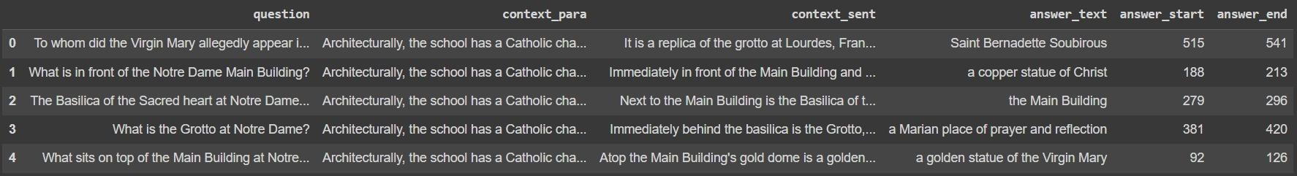

About Datasets
SQuAD
Stanford Question Answering Dataset
The SQuAD 1.1 dataset is a collection of question- answer pairs designed to test machine reading comprehension. The dataset contains over 100,000 question-answer pairs The dataset was sourced from articles on various topics, from history and science to politics and current events. SQuAD focuses on the task of question answering. It tests a model’s ability to read a passage of text and then answer questions about it.
What makes SQuAD so good?
The key improvement that SQuAD makes on this aspect is that its answers are more complex and thus require more- intensive reasoning, thus making SQuAD better for evaluating model understanding and capabilities. The SQuAD dataset presents a challenging task for machine reading comprehension models, as it requires answering questions based on a single passage, whereas other datasets allow access to multiple documents.

Slide 5

Question Answer Generation
1
For Question Answer Generation, we fine-tuned of T5-small transfomer based model on SQuAD1.1 dataset as discussed earlier.
2
We also made use of Pytorch lightning data module in order to reduce the training time.
The T5-small transformer takes an input of 'answer'+<sep>+'context' and output format is 'answer'+<sep>+'context'. The answer can be replaced with a [MASK] token with replacement probability of 0.3 to avoid overfitting.
3
Hyperparameters selected for our model are:-
i. No of Epochs = 4
ii. Source Max Token Length = 512
iii. Target Max Token Length = 128
iv. Batch Size = 8
v. Learning Rate = 0.00005
4

Slide 6
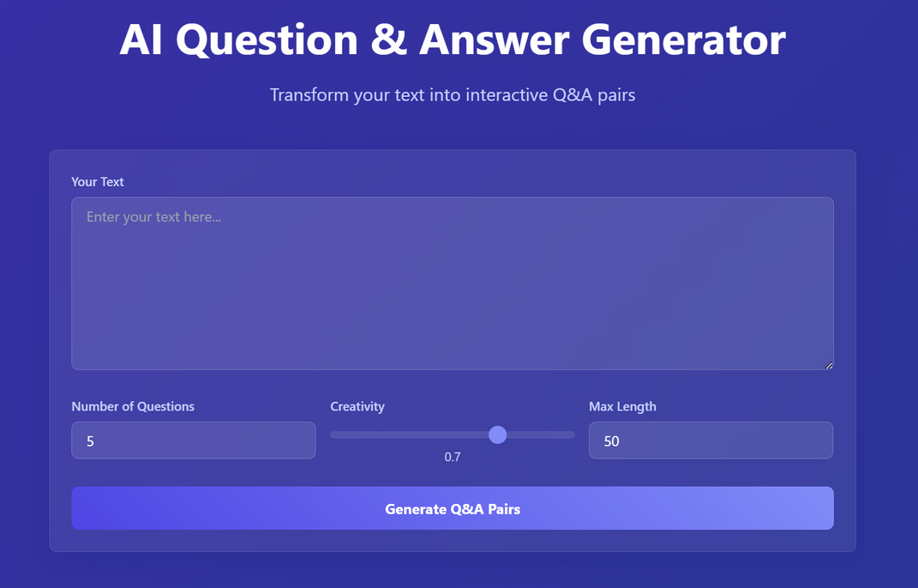
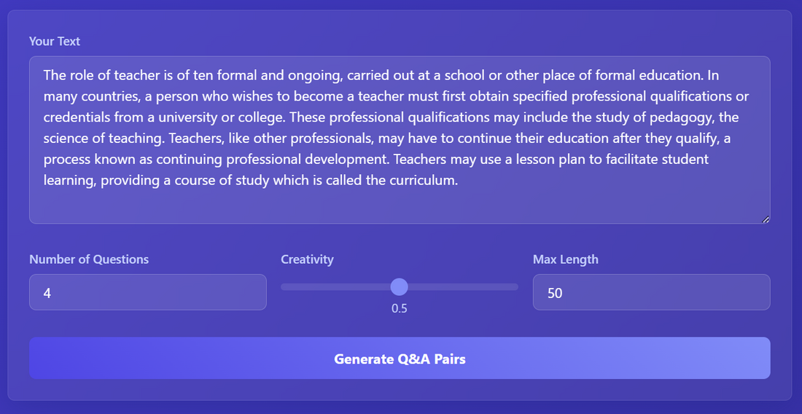

Snapshots

Slide 7
Future Enhancements
Planned Improvements
Model fine-tuning for specific domains
Multiple language support
Enhanced answer validation
Additional question types:
User feedback integration
Performance optimization
API rate limiting
Export functionality

Slide 8
Thank You!!

